Slide 1
KELOMPOK OKSIGEN
APLIKASI TOKO KLONTONG O2
ANGGOTA
Dina Ayunita P
Rezky Febrian
Rifka Alfauziyah
Trihayu Mulyantasi
Notes:
This template can be used as a starter file to give updates for project milestones.
Sections
Right-click on a slide to add sections. Sections can help to organize your slides or facilitate collaboration between multiple authors.
Notes
Use the Notes section for delivery notes or to provide additional details for the audience. View these notes in Presentation View during your presentation.
Keep in mind the font size (important for accessibility, visibility, videotaping, and online production)
Coordinated colors
Pay particular attention to the graphs, charts, and text boxes.
Consider that attendees will print in black and white or grayscale. Run a test print to make sure your colors work when printed in pure black and white and grayscale.
Graphics, tables, and graphs
Keep it simple: If possible, use consistent, non-distracting styles and colors.
Label all graphs and tables.

Slide 2
Latar Belakang
Dalam perkembangan teknologi yang semakin pesat saat ini, dimana kebutuhan akan tenaga-tenaga profesional akan semakin diperlukan oleh perusahaan besar maupun perusahaan kecil. Tidak lepas dari perkembangan teknologi tersebut maka dibutuhkan sarana pendukung yang sempurna yaitu komputer. Komputer adalah salah satu sarana terpenting bagi perusahaan dimana kita dapat mengolah dan mengakses data yang diperlukan dengan cepat dan tepat sehingga dapat memanfaatkan waktu yang tersisa dengan kegiatan-kegiatan yang lain. Dengan di sediakannya berbagai fasilitas yang dimiliki oleh komputer, maka tidak diragukan lagi bahwa setiap pimpinan menginginkan perusahaannya dilengkapi dengan komputer beserta program aplikasi yang sesuai dengan bidang usaha pada perusahaan tersebut. Program aplikasi ini akan semakin mempermudah dan mempercepat kinerja perusahaan dalam proses transaksi usaha sehari-hari.
Notes:
What is the project about?
Define the goal of this project
Is it similar to projects in the past or is it a new effort?
Define the scope of this project
Is it an independent project or is it related to other projects?
* Note that this slide is not necessary for weekly status meetings

Slide 3
Latar Belakang
Toko Klontong bergerak dalam bidang penjualan sembako dan kebutuhan sehari-hari lainnya. Transaksi yang dilakukan setiap harinya cukup besar. Pada saat ini sistem penjualan pada Toko Klontong masih dilakukan secara manual sehingga kinerjanya belum efektif terjadi penumpukan arsip yang tidak teratur dan belum tersedianya tempat penyimpanan arsip, sehingga keamanan dari datanya kurang terjamin. Selain dari waktu yang banyak terbuang dari proses pencarian data pun mengalami kesulitan dan sering terjadi kesalahan dalam pengolahan data penjualan. Hal itu tercermin pada seringnya terjadi keterlambatan penyusunan laporan penjualan dan piutang dagang, kesalahan pencatatan dan perhitungan persediaan, serta pengulangan dalam pencatatan transaksi. Oleh karena itu, toko Klontong bermaksud mengkomputerisasikan sistem bagian penjualan untuk memaksimalkan kinerjanya. Diharapkan setelah sistem pembelian dan penjualan terkomputerisasi, maka pengumpulan, penyimpanan, dan pengolahan data transaksi dapat dilakukan secara akurat dan cepat
Notes:
What is the project about?
Define the goal of this project
Is it similar to projects in the past or is it a new effort?
Define the scope of this project
Is it an independent project or is it related to other projects?
* Note that this slide is not necessary for weekly status meetings

Slide 4
Latar Belakang
Permasalahan pada Toko Klontong adalah belum menggunakan program aplikasi berbasis komputer. Hal inilah yang menghambat proses transaksi barang sehari-hari. Dengan keadaan inilah yang mendorong kami penulis kelompok oksigen untuk mengadakan penelitian serta membuat sistem aplikasi untuk mempermudah semua proses penyimpanan data dan transaksi barang Berdasarkan uraian diatas, maka kami penulis tertarik untuk meneliti mengenai sistem informasi penjualan dan pembelian. Oleh karena itu penulis, dalam penyusunan tugas UAS mata kuliah system design analys ini penulis akan mengambil judul : “PERANCANGAN SISTEM INFORMASI PENJUALAN DAN PEMBELIAN BARANG PADA TOKO KLONTONG” Sistem komputerisasi ini diharapkan dapat memberikan kemudahan dalam memperoleh informasi yang dibutuhkan.
Notes:
What is the project about?
Define the goal of this project
Is it similar to projects in the past or is it a new effort?
Define the scope of this project
Is it an independent project or is it related to other projects?
* Note that this slide is not necessary for weekly status meetings

Slide 5

Login
Design Form Program
Notes:
What is the project about?
Define the goal of this project
Is it similar to projects in the past or is it a new effort?
Define the scope of this project
Is it an independent project or is it related to other projects?
* Note that this slide is not necessary for weekly status meetings

Slide 6
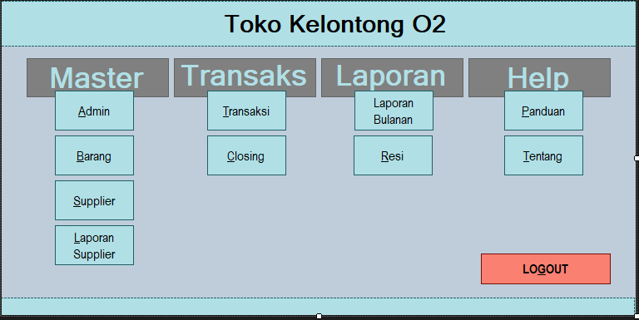
Menu Utama
Design Form Program
Notes:
What is the project about?
Define the goal of this project
Is it similar to projects in the past or is it a new effort?
Define the scope of this project
Is it an independent project or is it related to other projects?
* Note that this slide is not necessary for weekly status meetings

Slide 7
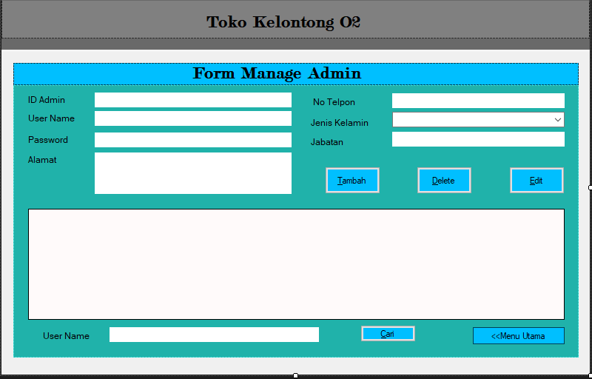
Form Admin
Design Form Program
Notes:
What is the project about?
Define the goal of this project
Is it similar to projects in the past or is it a new effort?
Define the scope of this project
Is it an independent project or is it related to other projects?
* Note that this slide is not necessary for weekly status meetings

Slide 8
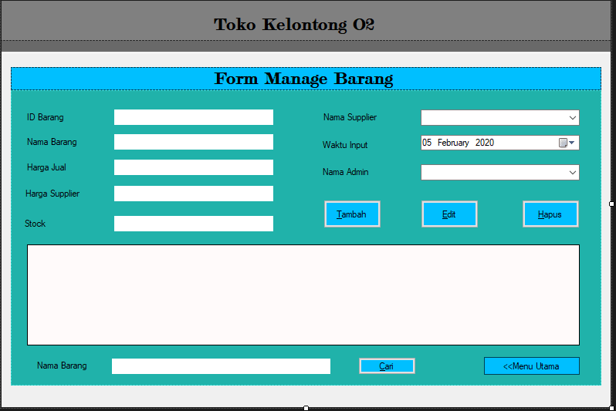
Form Barang
Design Form Program
Notes:
What is the project about?
Define the goal of this project
Is it similar to projects in the past or is it a new effort?
Define the scope of this project
Is it an independent project or is it related to other projects?
* Note that this slide is not necessary for weekly status meetings

Slide 9
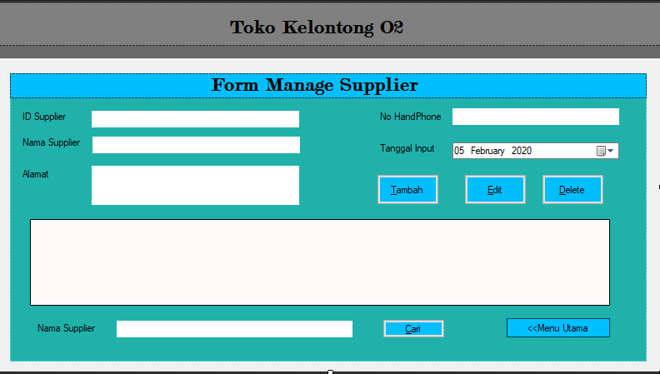
Form Supplier
Design Form Program
Notes:
What is the project about?
Define the goal of this project
Is it similar to projects in the past or is it a new effort?
Define the scope of this project
Is it an independent project or is it related to other projects?
* Note that this slide is not necessary for weekly status meetings

Slide 10
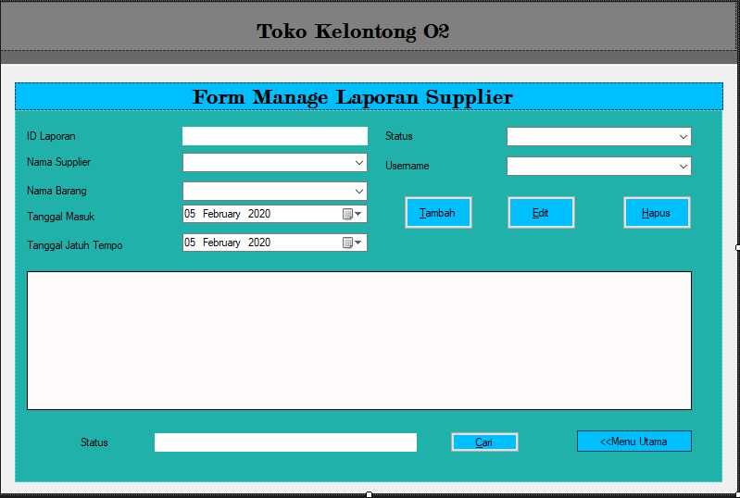
Form Laporan Supplier
Design Form Program
Notes:
What is the project about?
Define the goal of this project
Is it similar to projects in the past or is it a new effort?
Define the scope of this project
Is it an independent project or is it related to other projects?
* Note that this slide is not necessary for weekly status meetings

Slide 11
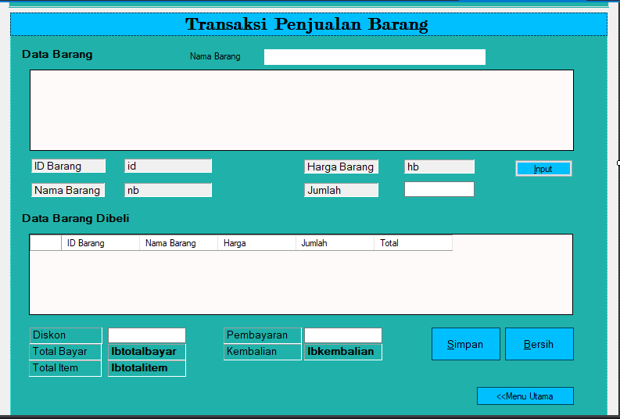
Form Transaksi Penjualan Barang
Design Form Program
Notes:
What is the project about?
Define the goal of this project
Is it similar to projects in the past or is it a new effort?
Define the scope of this project
Is it an independent project or is it related to other projects?
* Note that this slide is not necessary for weekly status meetings

Slide 12
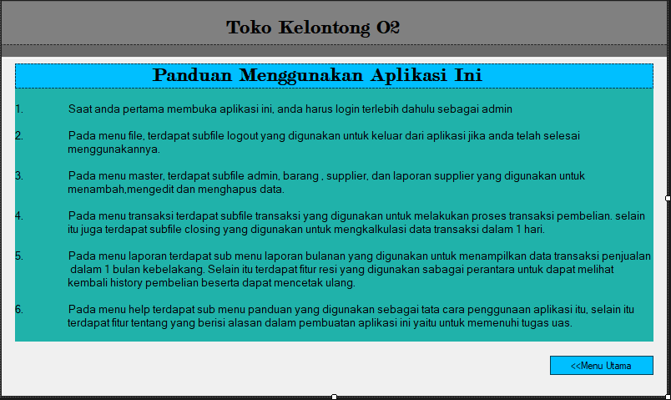
Form Panduan Aplikasi
Design Form Program
Notes:
What is the project about?
Define the goal of this project
Is it similar to projects in the past or is it a new effort?
Define the scope of this project
Is it an independent project or is it related to other projects?
* Note that this slide is not necessary for weekly status meetings

Slide 13
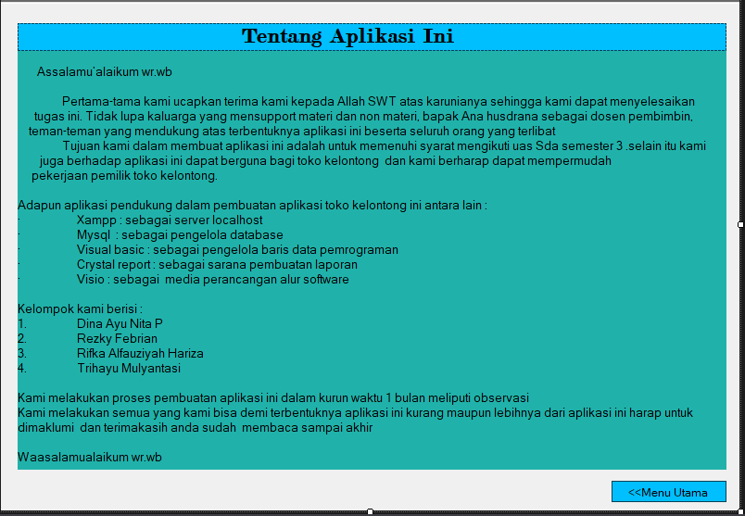
Form Tentang Aplikasi
Design Form Program
Notes:
What is the project about?
Define the goal of this project
Is it similar to projects in the past or is it a new effort?
Define the scope of this project
Is it an independent project or is it related to other projects?
* Note that this slide is not necessary for weekly status meetings

Slide 14
ERD (ENTITY RELATION DIAGRAM
Notes:
What is the project about?
Define the goal of this project
Is it similar to projects in the past or is it a new effort?
Define the scope of this project
Is it an independent project or is it related to other projects?
* Note that this slide is not necessary for weekly status meetings

Slide 15
CDM (CONCEPTUAL DATA MODEL)
Notes:
What is the project about?
Define the goal of this project
Is it similar to projects in the past or is it a new effort?
Define the scope of this project
Is it an independent project or is it related to other projects?
* Note that this slide is not necessary for weekly status meetings

Slide 16
DATA FLOW DIAGRAM
Notes:
What is the project about?
Define the goal of this project
Is it similar to projects in the past or is it a new effort?
Define the scope of this project
Is it an independent project or is it related to other projects?
* Note that this slide is not necessary for weekly status meetings

Slide 17
DATA FLOW DIAGRAM
Notes:
What is the project about?
Define the goal of this project
Is it similar to projects in the past or is it a new effort?
Define the scope of this project
Is it an independent project or is it related to other projects?
* Note that this slide is not necessary for weekly status meetings

Slide 18
DATA FLOW DIAGRAM
Notes:
What is the project about?
Define the goal of this project
Is it similar to projects in the past or is it a new effort?
Define the scope of this project
Is it an independent project or is it related to other projects?
* Note that this slide is not necessary for weekly status meetings

Slide 19
DATA FLOW DIAGRAM
Notes:
What is the project about?
Define the goal of this project
Is it similar to projects in the past or is it a new effort?
Define the scope of this project
Is it an independent project or is it related to other projects?
* Note that this slide is not necessary for weekly status meetings

Slide 20
DATA FLOW DIAGRAM
Notes:
What is the project about?
Define the goal of this project
Is it similar to projects in the past or is it a new effort?
Define the scope of this project
Is it an independent project or is it related to other projects?
* Note that this slide is not necessary for weekly status meetings

Slide 21
DATA FLOW DIAGRAM
Notes:
What is the project about?
Define the goal of this project
Is it similar to projects in the past or is it a new effort?
Define the scope of this project
Is it an independent project or is it related to other projects?
* Note that this slide is not necessary for weekly status meetings

Slide 22
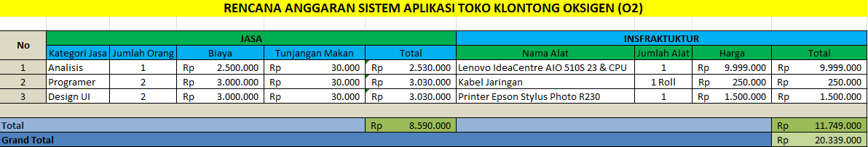
RINCIAN ANGGARAN BIAYA
Notes:
What is the project about?
Define the goal of this project
Is it similar to projects in the past or is it a new effort?
Define the scope of this project
Is it an independent project or is it related to other projects?
* Note that this slide is not necessary for weekly status meetings

Slide 23

TERIMA KASIH
Notes:
Prepare slides for the appendix in the event that more details or supplemental slides are needed. The appendix is also useful if the presentation is distributed later.

